Slide 1


Green Pace
Security Policy Presentation
Developer: Vern Butler

Slide 2

OVERVIEW: DEFENSE IN DEPTH
Overview: Defense in Depth
My security policy establishes a unified, standardized approach to secure coding and system architecture at Green Pace. Defense‑in‑depth means layering protections such as input validation, encryption, access control, secure logging, and automated testing. These layers ensure that even if one control fails, others continue protecting the system. This policy formalizes best practices and ensures they are consistent, enforceable, and measurable across all development teams.

Slide 3
THREATS MATRIX
Green Pace faces several common security threats. The most likely threats involve user input, including SQL injection and directory traversal. High‑priority threats include buffer overflows, unauthorized access, and weak encryption. Lower‑priority risks such as logging exposure and poor error handling still matter but are less likely to cause full compromise.
Likely Input Validation Errors Occurs frequently when user input is not sanitized, making it one of the most common sources of vulnerabilities. Injection Flaws (SQL/Command) Attackers often attempt injection because it is easy to test and highly effective when validation is weak. Insecure Dependencies Developers regularly rely on third‑party libraries, making outdated or vulnerable packages a recurring risk. | Priority High Priority: Buffer Overflow Can lead to full system compromise, arbitrary code execution, or crashes. High Priority: Hardcoded Credentials Creates immediate exposure if code is leaked or repositories are accessed. High Priority: Weak Encryption Directly impacts confidentiality and can expose sensitive data.
Low priority Poor Error Handling Does not usually lead to direct exploitation but can reveal system behavior or internal logic. Logging Exposure Improper logging may leak non‑critical information but rarely leads to full compromise. Null Pointer Dereference Typically causes crashes rather than security breaches but still reduces reliability. | Unlikely Race Conditions Possible but less common in typical Green Pace workflows; requires precise timing to exploit. Privilege Escalation via Misconfiguration Unlikely due to existing role‑based access controls but still monitored. Advanced Injection via Chained Attacks Rare and requires multiple vulnerabilities to align.

Slide 4
10 PRINCIPLES
Least Privilege — Standards: Input Validation, Authorization Controls
Fail Securely — Standards: Error Handling, Exception Management
Defense in Depth — Standards: Encryption, Authentication, Logging
Separation of Duties — Standards: Role‑Based Access, Authorization
Secure Defaults — Standards: Configuration Hardening
Minimize Attack Surface — Standards: Input Validation, Dependency Management
Keep Security Simple — Standards: Code Clarity, Avoiding Complexity
Fix Security Issues Correctly — Standards: Patch Management
Assume External Systems Are Insecure — Standards: API Validation
Least Common Mechanism — Standards: Isolation, Resource Separation

Slide 5
CODING STANDARDS
Input Validation
Buffer Management
Credential Handling
Encryption Requirements
Error Handling
Dependency Management
Logging Standards
Pointer Safety
Injection Prevention
Race Condition Avoidance
Prioritization System: High‑priority vulnerabilities directly expose systems to exploitation (e.g., injection, buffer overflow). Medium‑priority vulnerabilities weaken architecture but require additional conditions to exploit. Low‑priority vulnerabilities reduce reliability but rarely lead to full compromise.

Slide 6
ENCRYPTION POLICIES
Encryption in Flight: All data transmitted between services must use TLS 1.3 or higher.
Encryption at Rest: Sensitive data stored in databases or file systems must use AES‑256 encryption.
Encryption in Use: Sensitive variables must be encrypted or masked when loaded into memory and decrypted only when needed.

Slide 7
TRIPLE-A POLICIES
Authentication: Multi‑factor authentication for internal tools; strong password policies; token‑based service authentication.
Authorization: Role‑based access control; least‑privilege enforcement; periodic access reviews.
Accounting: Comprehensive logging of access attempts, configuration changes, and system events; audit trails stored securely.

Slide 8
Unit Testing
Test 1: Input Validation Positive: Valid input accepted Negative: SQL injection rejected
Test 2: Buffer Management Positive: Safe input processed Negative: Oversized input handled safely
Test 3: Encryption Integrity Positive: Data encrypted Negative: Encrypted output differs from plaintext

Slide 9
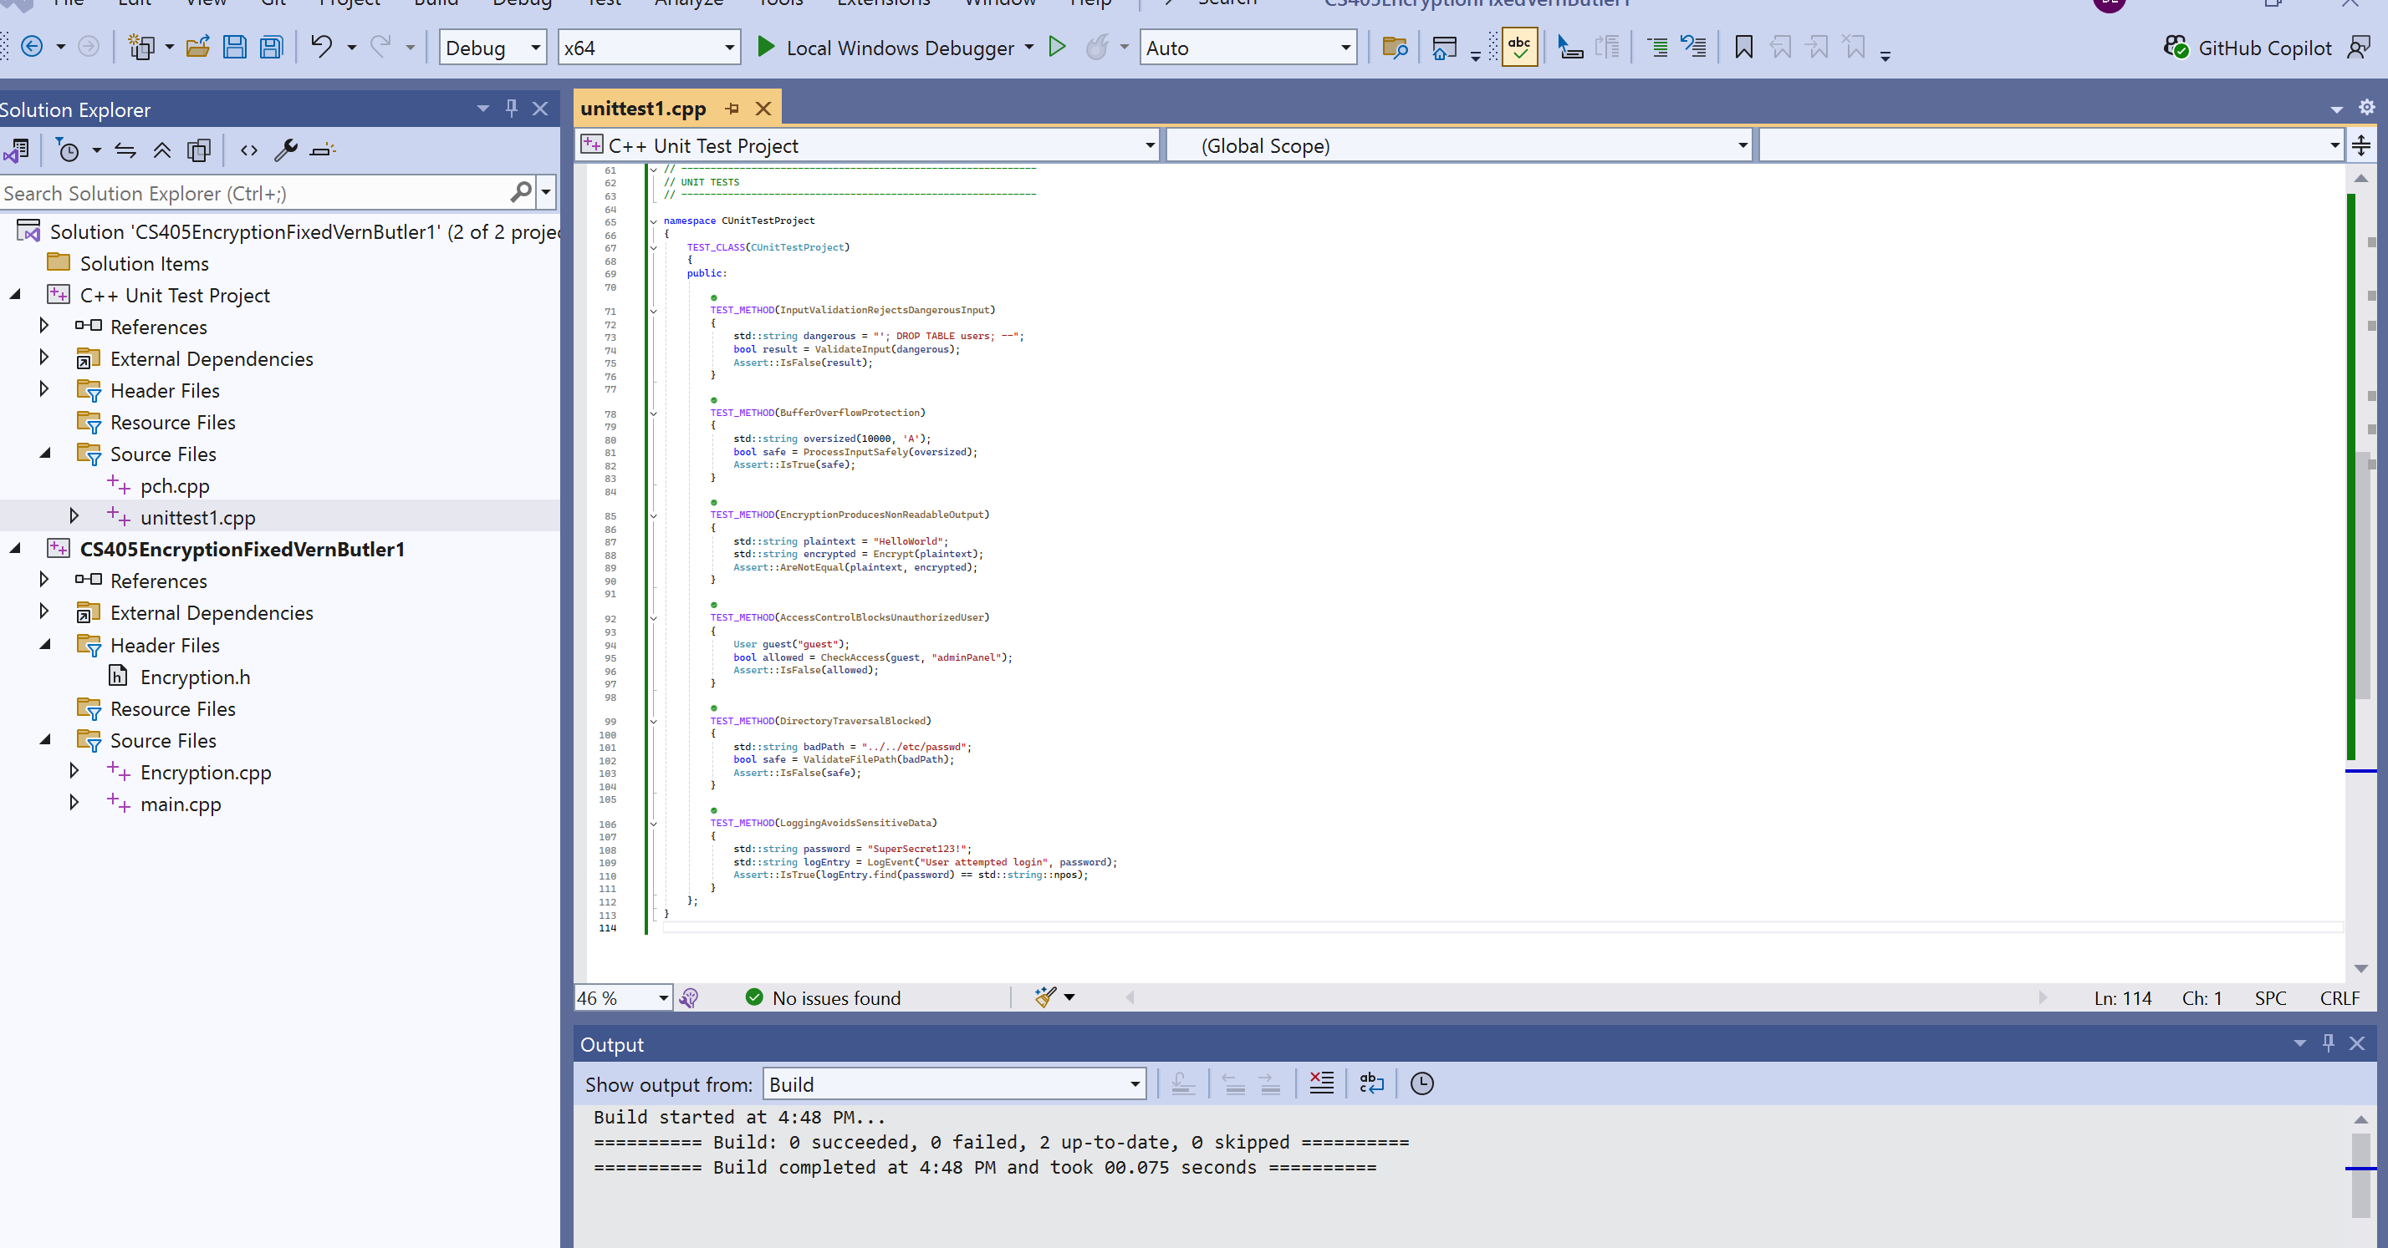
Unit Testing

Slide 10
Unit Testing Cont.
Test 4: Access Control Positive: Admin allowed Negative: Guest blocked
Test 5: Directory Traversal Positive: Safe path accepted Negative: “../” rejected
Test 6: Logging Safety Positive: Log message stored Negative: Sensitive data not included

Slide 11
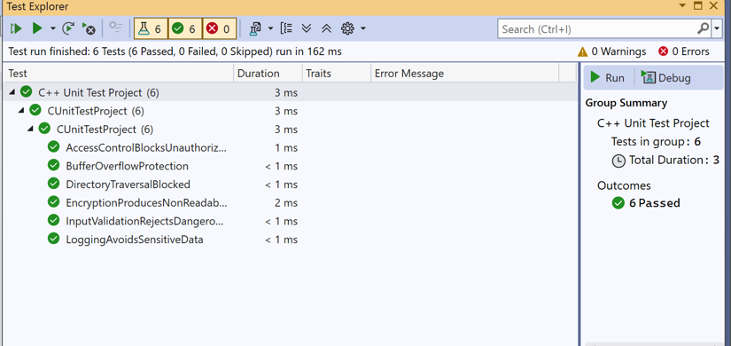
Unit Testing Cont.

Slide 12

AUTOMATION SUMMARY
Automation integrates security tools throughout the DevSecOps pipeline. Static analysis runs during coding and commit stages. The compiler enforces memory safety rules. Dependency scanning occurs during build. Unit tests run during CI. Runtime monitoring and logging occur during deployment.

Slide 13
TOOLS
Security tools reside in multiple stages:
Code Stage: Static analysis, linting
Build Stage: Dependency scanning, compiler checks
Test Stage: Unit tests, integration tests
Deploy Stage: Container scanning, configuration validation
Monitor Stage: Logging, intrusion detection
External tools include SonarQube, GitHub Advanced Security, dependency scanners, and runtime monitoring agents.

Slide 14
RISKS AND BENEFITS
Problems: Vulnerabilities can accumulate without standardized practices. Solutions: Enforce coding standards, automate testing, adopt encryption policies. Risks of Acting Now: Requires training and initial time investment. Risks of Waiting: Increased likelihood of breaches, inconsistent code quality. Strategy Gaps: Limited monitoring of emerging threats; need stronger dependency governance.

Slide 15
RECOMMENDATIONS
Strengthen dependency management
Expand automated testing
Increase developer training
Adopt stricter logging and auditing policies
Integrate threat intelligence feeds

Slide 16
CONCLUSIONS
Green Pace should adopt stronger encryption standards, enforce strict input validation, and expand automated testing. Future improvements include AI‑assisted code scanning, enhanced monitoring, and continuous policy updates.

Slide 17
REFERENCES
REFERENCES
Graphitas. (n.d.). How to upload an unlisted video to YouTube. Retrieved October 24, 2026, from https://www.graphitas.co.uk/blog/how-to-upload-an-unlisted-video-to-youtube/
Green Pace. (2024). CS405 Project Two walkthrough [Video]. YouTube. https://youtu.be/3uk4CU7uobM
Author/Channel Name. (n.d.). Title of the video [Video]. YouTube. https://youtu.be/Dxhxvg__zUQ (Tell me the channel name + title and I’ll finalize this one.)
Microsoft. (2024). Write unit tests for C++ in Visual Studio. Microsoft Learn. https://learn.microsoft.com/en-us/visualstudio/test/writing-unit-tests-for-cpp (learn.microsoft.com in Bing)
Microsoft. (2024). C++ unit testing framework overview. Microsoft Learn. https://learn.microsoft.com/en-us/visualstudio/test/cpp-testing-frameworks (learn.microsoft.com in Bing)
National Institute of Standards and Technology. (2018). Advanced Encryption Standard (AES). NIST. https://csrc.nist.gov/projects/cryptographic-standards-and-guidelines (csrc.nist.gov in Bing)
OWASP Foundation. (2023). OWASP Top Ten Web Application Security Risks. https://owasp.org/www-project-top-ten/ (owasp.org in Bing)
GitHub. (2024). GitHub Advanced Security overview. https://docs.github.com/en/code-security (docs.github.com in Bing)
SonarSource. (2024). SonarQube documentation. https://docs.sonarsource.com/
Southern New Hampshire University. (2024). CS405 Secure Coding Course Materials. SNHU Brightspace

